Slide 1
Lecture 9
The Body as an Instrument of the Self

Slide 2
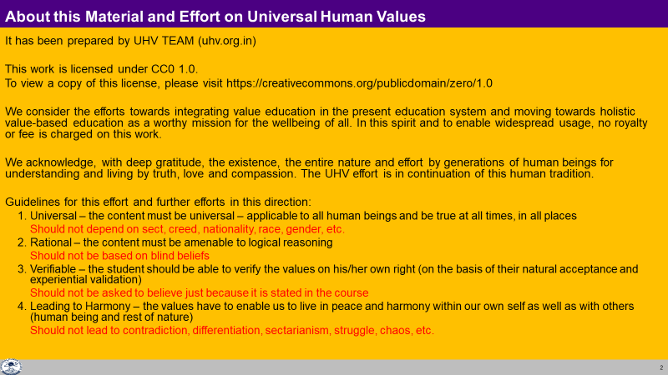

Slide 3
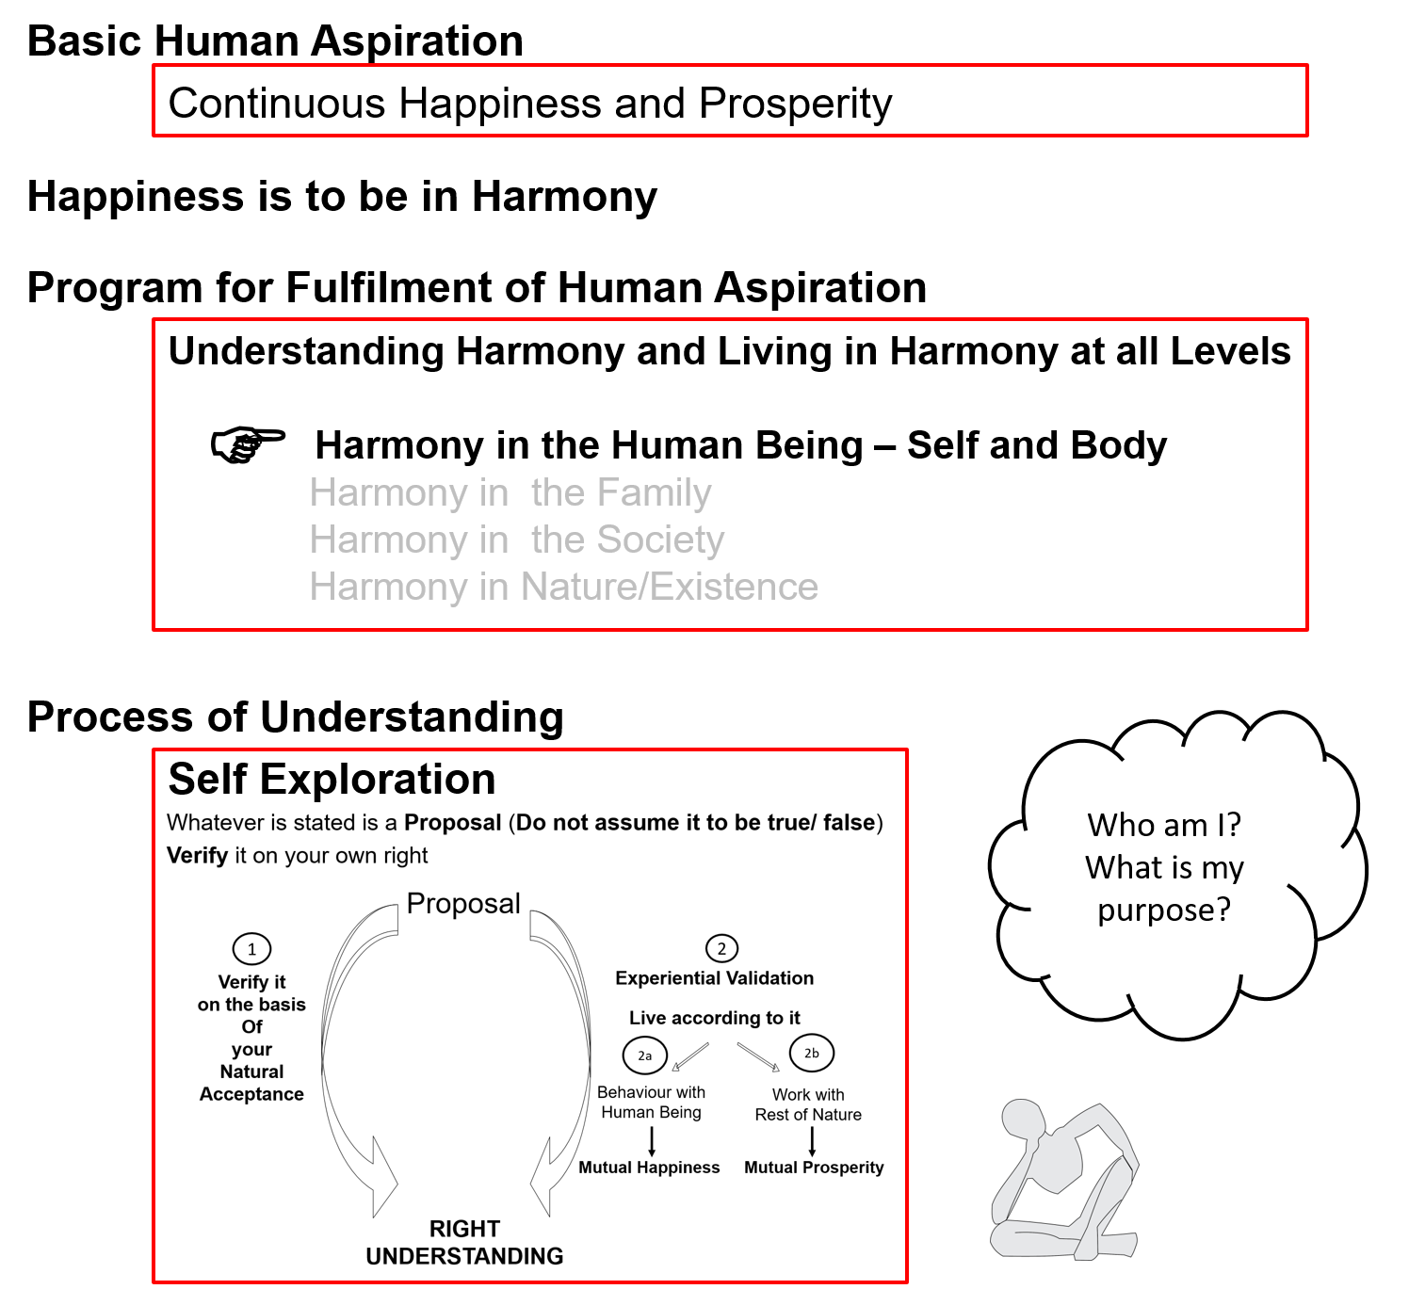

Slide 4
the
Human Being Ekkuo | Self eSa | Body “kjhj
Need vko';drk | Happiness (e.g. Respect) lq[k ¼tSls lEeku½ | Physical Facility (e.g. Food) lqfo/kk ¼tSls Hkkstu½
In Time dky esa | Continuous fujUrj | Temporary lkef;d
In Quantity ek=k esa | Qualitative (is Feeling) xq.kkRed ¼Hkko gS½ | Quantitative (Required in Limited Quantity) Ekk=kRed ¼lhfer ek=k esa½
Fulfilled By iwfrZ ds fy, | Right Understanding & Right Feeling lgh le>] lgh Hkko | Physio-chemical Things HkkSfrd&jklk;fud oLrq
Co-existence
lg-vfLrRo
Consciousness
Material
The needs of the Self are fulfilled by the activity of the Self
Decisions re. the fulfilment of the needs of the Body are made by the Self
Decisions re. the use of the Body are made by the Self
Self is central to human existence
Notes:
Key point
The need of consciousness is fulfilled by activities of consciousness
Elaboration
Need of the Self is feeling in consciousness
Fulfilled by Activities of consciousness
(can’t be fulfilled by material – will come later)
Examples
Fulfilled by
Flower to Father – flower is only a symbol. Feeling is primary. Feelings ka bandh mein band kar rakha hai – feelings ka aadan-pradan nahin hota. Feelings ka exchange bhi sukhi hone ka tareeka hai, yeh dhyan mein nahin aaya rahta
One cant fulfill the other
Exclusive dress – attention neq respect. Dress se attention bhar mil paata hai

Slide 5
Co-existence
lgvfLrRo
Human Being Ekkuo | Self eSa | Body “kjhj
Consciousness |  | Material
INFORMATION
Instruction
Sensation
The transaction between Self and Body is only in the form of information

Slide 6
Co-existence
lgvfLrRo
Human Being Ekkuo | Self eSa | Body “kjhj
Consciousness |  | Material
I am |  | My body is
I want to live |  | My body is used as an instrument
INFORMATION
Instruction
Sensation

Slide 7
Co-existence
lgvfLrRo
Human Being Ekkuo | Self eSa | Body “kjhj
Consciousness |  | Material
I am |  | My body is
I want to live |  | My body is used as an instrument
I want to live with continuous happiness |  | Physical facility is required for nurturing, protection and right utilization of the body
INFORMATION
Instruction
Sensation

Slide 8
Co-existence
lgvfLrRo
Human Being Ekkuo | Self eSa | Body “kjhj
Consciousness |  | Material
I am |  | My body is
I want to live |  | My body is used as an instrument
I want to live with continuous happiness |  | Physical facility is required for nurturing, protection and right utilization of the body
To understand and to live in harmony at all levels of being (from self to entire existence) is my program of action for continuous happiness |  | Production, protection and right utilization of physical facility is a part of my program (<1/4th)
INFORMATION
Instruction
Sensation
Self is central to human existence
The Body is an instrument of the Self

Slide 9
Sum Up
Human Being is the co-existence of Self and Body
The transaction between Self and Body is only in the form of information
The Self decides how to fulfill its needs as well as the needs of the Body
The need of the Self is continuous happiness. It is fulfilled by right understanding and right feeling in the Self. For this, the program of the Self is
to understand harmony and
to live in harmony
The need of the Body is physical facility. It is fulfilled by physio-chemical things
For this, the program of the Self is using the Body for production, protection and right utilization of physical facility. This is the smaller part of the full program of the Self
Self is central to human existence. The Body is used as an instrument by the Self
at all levels of being
  1. As an individual human being 2. As a member of the family
  3. As a member of society 4. As an unit in nature/existence

Slide 10
Sum Up
Human Being is the co-existence of Self and Body
I want to live with continuous happiness – I use the Body as an instrument, as and when required
The transaction between Self and Body is only in the form of information
Self is central to human existence
The need of the Self is continuous happiness
For this, the program of the Self is:
To understand harmony &
To live in harmony
Production, protection and right utilization of physical facility is a part of my program (<1/4th)
at all levels of being
  As an individual human being
  As a member of the family
  As a member of society
  As an unit in nature/existence

Slide 11
Self Reflection

Slide 12
Key Points
The Body as an Instrument of the Self

Slide 13
Human Being Ekkuo | Self eSa | Body “kjhj
Need vko';drk | Happiness (e.g. Respect) lq[k ¼tSls lEeku½ | Physical Facility (e.g. Food) lqfo/kk ¼tSls Hkkstu½
In Time dky esa | Continuous fujUrj | Temporary lkef;d
In Quantity ek=k esa | Qualitative (is Feeling) xq.kkRed ¼Hkko gS½ | Quantitative (Required in Limited Quantity) Ekk=kRed ¼lhfer ek=k esa½
Fulfilled By iwfrZ ds fy, | Right Understanding & Right Feeling lgh le>] lgh Hkko | Physio-chemical Things HkkSfrd&jklk;fud oLrq
Activity fØ;k | Desire, Thought, Expectation… bPNk] fopkj] vk”kk--- | Eating, Walking… [kkuk] pyuk---
In Time dky esa | Continuous fujUrj | Temporary lkef;d
Response | Knowing, Assuming, Recognising, Fulfilling tkuuk] ekuuk] igpkuuk] fuokZg djuk | Recognising, Fulfilling igpkuuk] fuokZg djuk
 | Consciousness pSrU; | Material tM+
Co-existence
lgvfLrRo

Slide 14
Self Body
Consciousness |  | Material
I am |  | My body is
I want to live |  | My body is used as an instrument
I want to live with continuous happiness |  | Physical facility is required for nurturing, protection and right utilization of the body
To understand and to live in harmony at all levels of being (from self to entire existence) is my program of action for continuous happiness |  | Production, protection and right utilization of physical facility is a part of my program (<1/4th)
I am the: Seer, Doer, Enjoyer (Experiencer) nz’Vk] drkZ] HkksDrk |  | I use the body as an instrument for fulfillment of my program
INFORMATION
Instruction
Sensation
The Self is
central to human existence
The Body is
an instrument of the Self

Slide 15
I am the Seer
“Seer” means the one that sees / understands
e.g. If you are given something in your hand and you conclude that it is a pen, it is not your eyes that concluded this. It is you that concluded this. The Self sees via the eyes – the eyes don’t see themselves
Like that all the 5 senses are just the instrument that enable the Self to see something outside
Just like you see outside, you can also see ‘within’, without using the body for sensation
e.g. You can ‘see’ that you are feeling happy, getting angry...
Thus, the Self ‘sees’ or understands, sometimes with the help of the body, sometimes without the help of body
The Body is used as an instrument

Slide 16
I am the Doer
“Doer” means the one that does, who takes decision to do
I am the one who decides. I decide what to do, what not to do...
I may or may not use the body to do – what I think of is my decision. I do that thinking within myself (there is no role of the body in this)
If required, the body is used to express my decision
The Body is used as an instrument

Slide 17
I am the Enjoyer (Experiencer)
“Enjoyer” means the one that experiences happiness / unhappiness
I am the one that feels enthused or depressed. I am the one that feels angry or delighted...
I am the enjoyer, the experiencer
The Body is used as an instrument

Slide 18
Instructions from self to body + reading sensations from body (not hard wired)
Body as an instrument of Self
Seer = ? Doer = ? Enjoyer = ?

Slide 19
FAQs for Lecture 9
The Body as an Instrument of the Self

Slide 20
Question(s): Response
If there is a pain in the body, the Self has to read that sensation, but it seems automatic in case of extreme pain. Please elaborate.
When we are not aware of the self, then even the ordinary sensations are read by the self while we are unconscious of it, therefore, it seems automatic. When we become aware, atleast we can see that these ordinary sensations are read by the self by choice. Then, comes this question about case of extreme pain. We will have to develop our capacity of being aware of the self in the case of extreme pain as well, then we will be able to see that self is reading the extreme pain by choice only, and that it can respond to the pain and not react, i.e. it will think of what to do for relieving this pain, rather than start crying.

Slide 21
Question(s): Response
Please elaborate on Self as the seer, doer and enjoyer
What is being said is that self is central in most of the human activities. When we are seeing something, it is the self who is seeing, in the process if necessary, it uses the 5 senses of the body to get the necessary information, for example, so many things are passing in front of our eyes but, we do not take note of them, we take note of only those things which self considers important. So, self is the seer. Similarly, when we want to do something, it is the self who is deciding what to do; once decided by the self, then if necessary, it takes help of the body for execution of that activity. Hence, self is the doer. It is certainly the self who experiences happiness or unhappiness. In that sense self is the enjoyer.

Slide 22
Question(s): Response
People take drugs like “ecstasy” for mood enhancement. Similarly medicines are used to take people out of depression. Does this not show that the body has an effect on the Self? (why go to drugs etc. – even unfavorable temperature, too hot or too cold, may be enough to put people in a foul mood)
Body certainly has an effect on the self, if the self is reading some sensation from the body and is influenced by it. Presently, we are so identified with the body that we almost think that what is happening to the body is happening to us, the self and therefore we react to any input that comes from body, we are not able to respond to it. For example, as we discussed in case of extreme pain, do we respond in terms of doing something to relieve the pain or we start crying. When a medicine is given to person in depression, he may seem to be out of it for sometime, but, does he really get cured, is it just a temporary diversion? Experiment being conducted by BIW, under the supervision of Dasho Pema Thinley is a good example of it and we would like to listen from him about it.

Slide 23
Question(s): Response
Mental retardation is a problem with the body or the self?
Feelings are in the heart. When a person gets a heart transplant, do the feelings also get transplanted?
Retardation in a person can be there for two reasons- either there is some problem at the level of body or at the level of self. So, this we have to find out first. For example, as body grows older, certain capacity of the body gets retarded, and we see its impact on the old people. On the other hand, we see many mad persons who seem very healthy at the level of body, this is a case of the problem of the self (mental).
What do you think? It will be interesting to check with a person who got a heart transplanted.

Slide 24
Question(s): Response
In one slide, it is written that production of physical facility is less than 1/4th of my program. Please explain why.
To ensure the fulfillment of the need of self i.e. continuous happiness, the program is to understand the harmony and live in harmony at all levels of our being. We identified the 4 levels as individual human being, family, society, nature/existence. Out of these 4, harmony in human being is 1 (1/4). Now, to ensure harmony in human being, we need to ensure harmony in the self and harmony with the body. To ensure harmony woth the body, we need physical facility, so production of physical facility is part of my program of ensuring harmony in human being, which itself is ¼ of my total program. Therefore, it is said that production of physical facility is less than 1/4th of my program.

Slide 25
Question(s): Response
We have been using the words self and body here. we also have these words like brain and mind. How do they relate to self and body? Can you explain them and their interrelationship?
Self is a conscious unit and body is a material unit (with their specific needs, activities and response) as we discussed in last three lectures.
Mind is a part of the self. In essence, it is the imagination part which includes the activities of desire, thought and expectation, this we will discuss in the next lecture.
Brain is a part of the body. Its role to coordinate the activities of different parts of the body. Information from different part of the body is collected in the brain and is available for the self to read. Similarly, instruction from the self is received in the brain and distributed to different parts of body. So, the brain does the work of coordination of the activities of different parts of the body.

Slide 26
Question(s): Response
As per science, thought, memory etc. are complex functions of the brain. Is that not true?
When we assume that human being is just the body, then every activity of human being has to be placed in the body. Now, when we look at human being as co-existence of the self and the the body (along with mind and brain as explained), we can understand the define the activities of the human being much better. But, this we have to work through and see it for ourselves. Probably, by the end of the course, we will be able to say this with much more affirmation than now.

Slide 27
Question(s): Response
How do I make out if the activity is taking place in the Self or the Brain?
One possible way could be to see the activities of these. If the activity performed is continuous, it is the activity of the self, if the continuity can not be maintained, it is the activity of the body which includes the brain. Thinking, for example, can go on continuously, therefore it is activity of the self. On the other hand if I instruct the body through brain to keep working according to my thinking continuously, it cannot; it will get tired after sometime, so, it is the activity of the body, coordinated through brain.

Slide 28
Question(s): Response
People lose their memory in accidents. In some cases the memory comes back after some time. How does this happen?
Memory is stored in the self, and it keeps updating it as per the importance it gives to the information. For example, if you have visited some place a year back, do you remember everything that you saw there? No, you remember those things which you consider important.
Further, to recall these memory, you may need some input from outside or from the body. If this is the case, then there is role of the body or brain in recalling the memory. Therefore if there is some degeneration in the brain, it may be difficult to recall these information.
...continued

Slide 29
Question(s): Response
People lose their memory in accidents. In some cases the memory comes back after some time. How does this happen?
...continued
In case of accident, it may be self does not want to recall that information because it is painful; so, till it comes to term with it, it does not want to recall. On the other hand, may be it requires some input from outside or from the body, in that case, self will require the involvement of the brain; now, if there is some temporary problem with brain, then self will have to wait till the. brain gets recovered. So, when brain gets recovered, self will be able to recall that particular information.
I thing that it is good to take this response as a conjecture and work on its details, then it will give us finer description of this process.

Slide 30
Question(s): Response
What is coma?
When someone is brain dead what happens to the Self?
Coma seems to be state when the self is not able to transact the information with body for all practical purposes. It therefore can not regulate the body, and somebody from outside has to help keep even the minimal functioning of the body.

